Slide 1
VEHICLE SERVICE MANAGEMENT SYSTEM

Slide 2
INTRODUCTION
PROJECT :- VEHICLE SERVICE MANAGEMENT SYSTEM.
NAME :- Abhishek Mishra & Nitesh Yadav.
SEAT NO :- 3022054 & 3022492 .
COLLEGE NAME :- CHANDRABHAN SHARMA COLLEGE OF ARTS , SCIENCE AND COMMERCE .
UNIVERSITY NAME :-MUMBAI UNIVERSITY .
GUIDE NAME :- Rajesh Maisalge.
DATE :- 21/04/2025.

Slide 3
INTRODUCTION TO VEHICLE SERVICE MANAGEMENT SYSTEM (VSMS).
🔹 BACKGROUND : The Vehicle Service Management System (VSMS) is developed to simplify and automate the management of vehicle service operations. It helps service centers efficiently handle customer bookings, service tracking, billing, and feedback management to improve overall service quality and customer experience.
🔹 IMPORTANCE OF IT : VSMS leverages modern web technologies to digitize service booking, job card management, billing, customer communication, and service history tracking. This automation enhances operational efficiency, reduces human error, and improves transparency for both customers and staff.
🔹 PROBLEM STATEMENT : Traditional vehicle service management methods suffer from issues like manual record keeping, service delays, lack of real-time updates, and ineffective communication with customers. VSMS addresses these challenges by introducing a centralized, automated platform for managing all aspects of vehicle servicing.

Slide 4
OBJECTIVES :-
🔹 Main Goals of the Project :
To digitize vehicle service operations through a centralized web-based platform.
To streamline service booking, reducing manual workload and scheduling conflicts.
To maintain real-time tracking of service status, spare parts, and inventory.
To enable admins to manage services, technicians, pricing, and customer records efficiently.
To improve customer experience with a responsive and intuitive interface.
To generate automated reports for service history, customer analytics, and operational performance.

Slide 5
OBJECTIVES :-
🔹 What We Aim to Achieve:
Develop a user-friendly portal for customers to book and track vehicle services.
Implement an admin dashboard for managing appointments, technicians, and inventory in real-time.
Ensure secure authentication and role-based access for admins, technicians, and customers.
Integrate dynamic invoice generation and real-time service tracking features.
Provide a scalable solution that supports future upgrades like mobile app integration, live chat support, and AI-based service recommendations.

Slide 6
Literature Review / Existing Systems
🔹 Existing Systems in Vehicle Service Centers
Manual Systems: Many local garages still rely on paper-based records for booking services, generating invoices, and tracking service history.
Basic Service Software: Some service centers use basic desktop software for billing or service entry, but lack integration with inventory or customer management.
Cloud-Based Workshop Solutions: A few high-end service providers use premium cloud-based CRMs, which are often costly and require technical staff for maintenance.
Standalone Inventory Tools: Inventory management tools are available, but they are usually not linked to job cards, billing, or appointment systems.

Slide 7
🔹 Limitations of Existing Systems
❌ No Real-Time Sync: Service updates, inventory changes, and billing aren’t automatically reflected across modules.
❌ No Central Dashboard: Managers lack a unified view of daily operations, customer activity, and financial reports.
❌ Lack of Customization: Most available tools aren't tailored for local garages or require high technical skills.
❌ No Remote Access: Many systems don't support web access, so owners can't manage or monitor services remotely.
❌ Weak Reporting & Analytics: Decision-making suffers due to the absence of detailed service, financial, or customer reports.

Slide 8
🔹 What Makes Our VSMS Project Unique
✅ Fully Web-Based System: Accessible anytime, from any device with a browser.
✅ All-in-One Solution: Seamlessly integrates service bookings, billing, inventory, customer management, and payments.
✅ Role-Based Access: Separate dashboards for Admins, Technicians, and Customers to streamline workflow and privacy.
✅ Tech Stack: Built using HTML, CSS, JavaScript, PHP, and MySQL – open-source and easy to maintain.
✅ Real-Time Updates: Instant data sync across all modules (e.g., booking updates inventory and generates invoices).
✅ Remote Access & Notifications: Email/SMS alerts, live dashboards, and support for future mobile integration.
✅ Customizable & Scalable: Easily modifiable for small garages or large service chains with multiple locations.

Slide 9
System Analysis Functional requirements.
1. User Management
Users must be able to register and log in with their credentials.
System should support role-based access (Admin, Customer, Mechanic).
Users should be able to update their profile information.
Forgot password/reset password functionality must be available.
2. Vehicle Management
Users can add, edit, and delete their vehicle information.
Each vehicle should be linked to a specific user account.
Admin or staff can view all registered vehicles.

Slide 10
System Analysis Functional requirements.
3. Service Booking & Appointment Scheduling
Users can book service appointments by selecting:
Car brand/model
Vehicle number
Type of service
Date and time
The system must check availability and prevent double bookings.
Users can view current and past appointments.
4. Service Catalog & Pricing
Admin can manage a list of services and their prices.
Customers should be able to view available services with descriptions and costs before booking.
System dynamically calculates service cost during booking.

Slide 11
System Analysis Functional requirements.
5.Work Order Management
Track work status updates: Pending, In Progress, Completed.
6. Payment Gateway Integration
Users can pay online via UPI, Credit/Debit Card, or Net Banking.
Payment status (Success/Failed) should be recorded in the database.
Users can view their payment history.
7. Service History & Reports
Users can view past service records for their vehicles.
Admin can generate reports for:
Daily/Monthly bookings
Revenue
Top services used

Slide 12
System Analysis Functional requirements.
9. Feedback & Ratings
After service, users can submit ratings and reviews.
Admin can view feedback for quality control.
10. Notifications & Alerts
System sends email/SMS notifications for:
Booking confirmation
Payment confirmation
Service completion
Upcoming appointment reminders should be sent in advance.

Slide 13
System Analysis Functional requirements.
11. Contact Us & Support
A contact form must be available to submit inquiries.
Admin receives the message via email and/or can view in dashboard.
Include live chat support for instant help (optional).
12. Admin Panel
Admin should be able to:
Manage users (approve/block)
Add/edit services
View bookings, payments, and reports
Assign service jobs to mechanics
Configure system settings

Slide 14
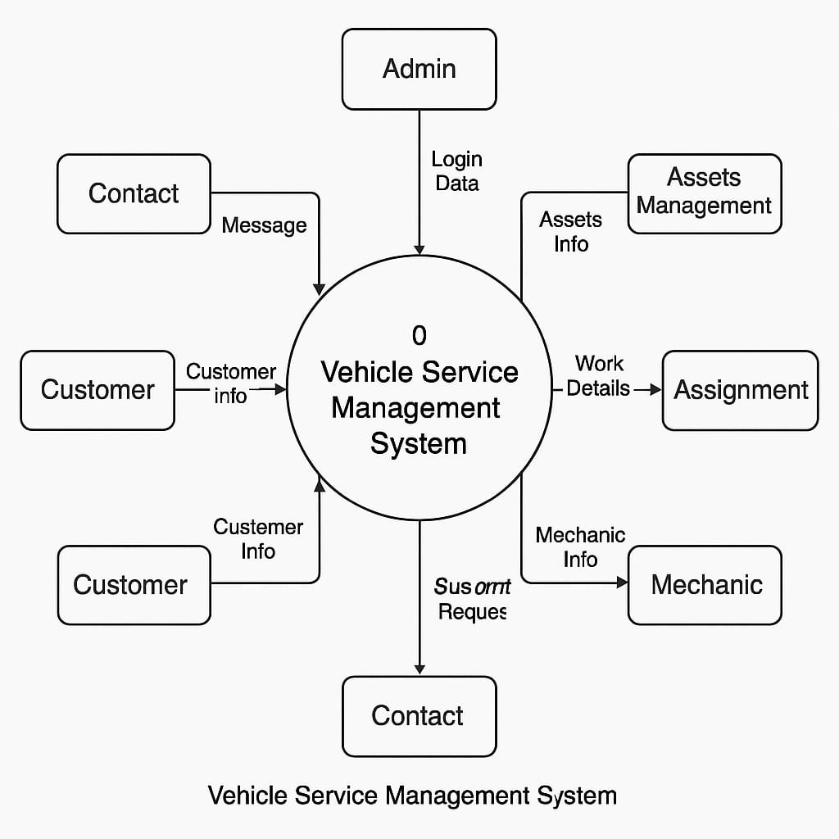
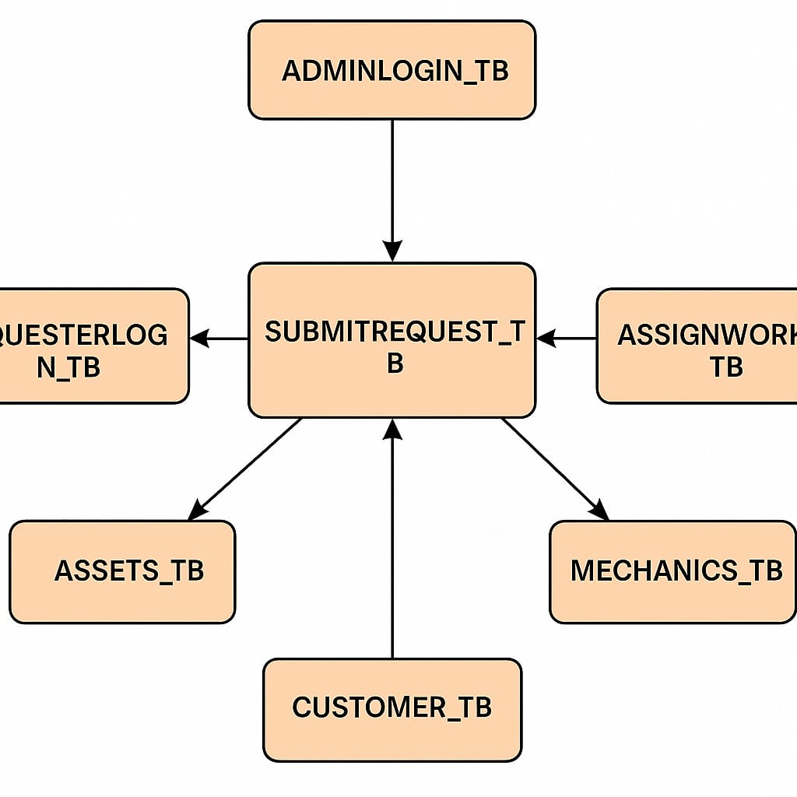
🏗️ System Design
DATA FLOW DIAGRAM
PROCEDURAL DIAGRAM

Slide 15
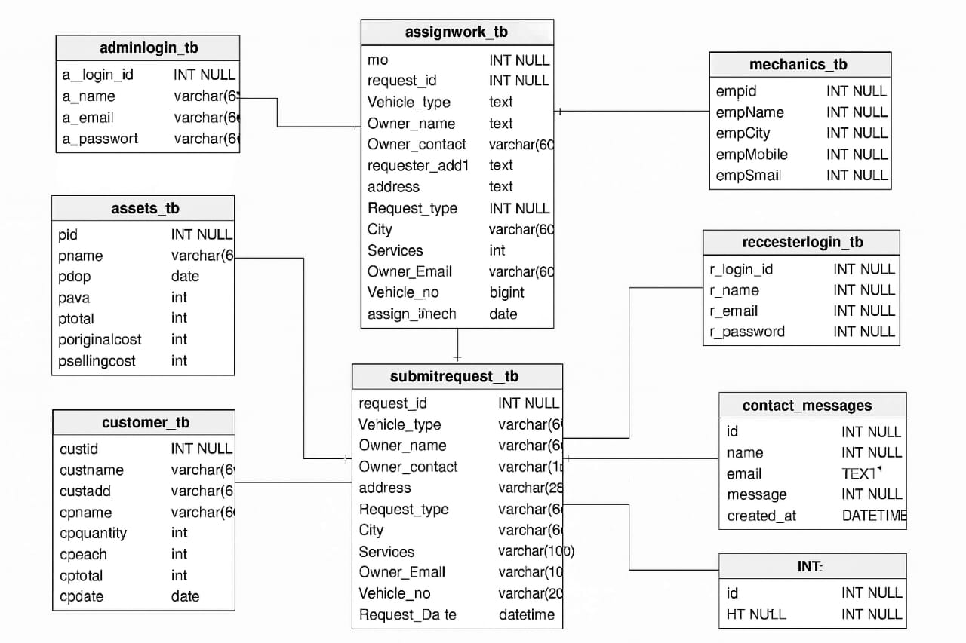
🏗️ System Design
DATA STRUCTURE DIAGRAM

Slide 16
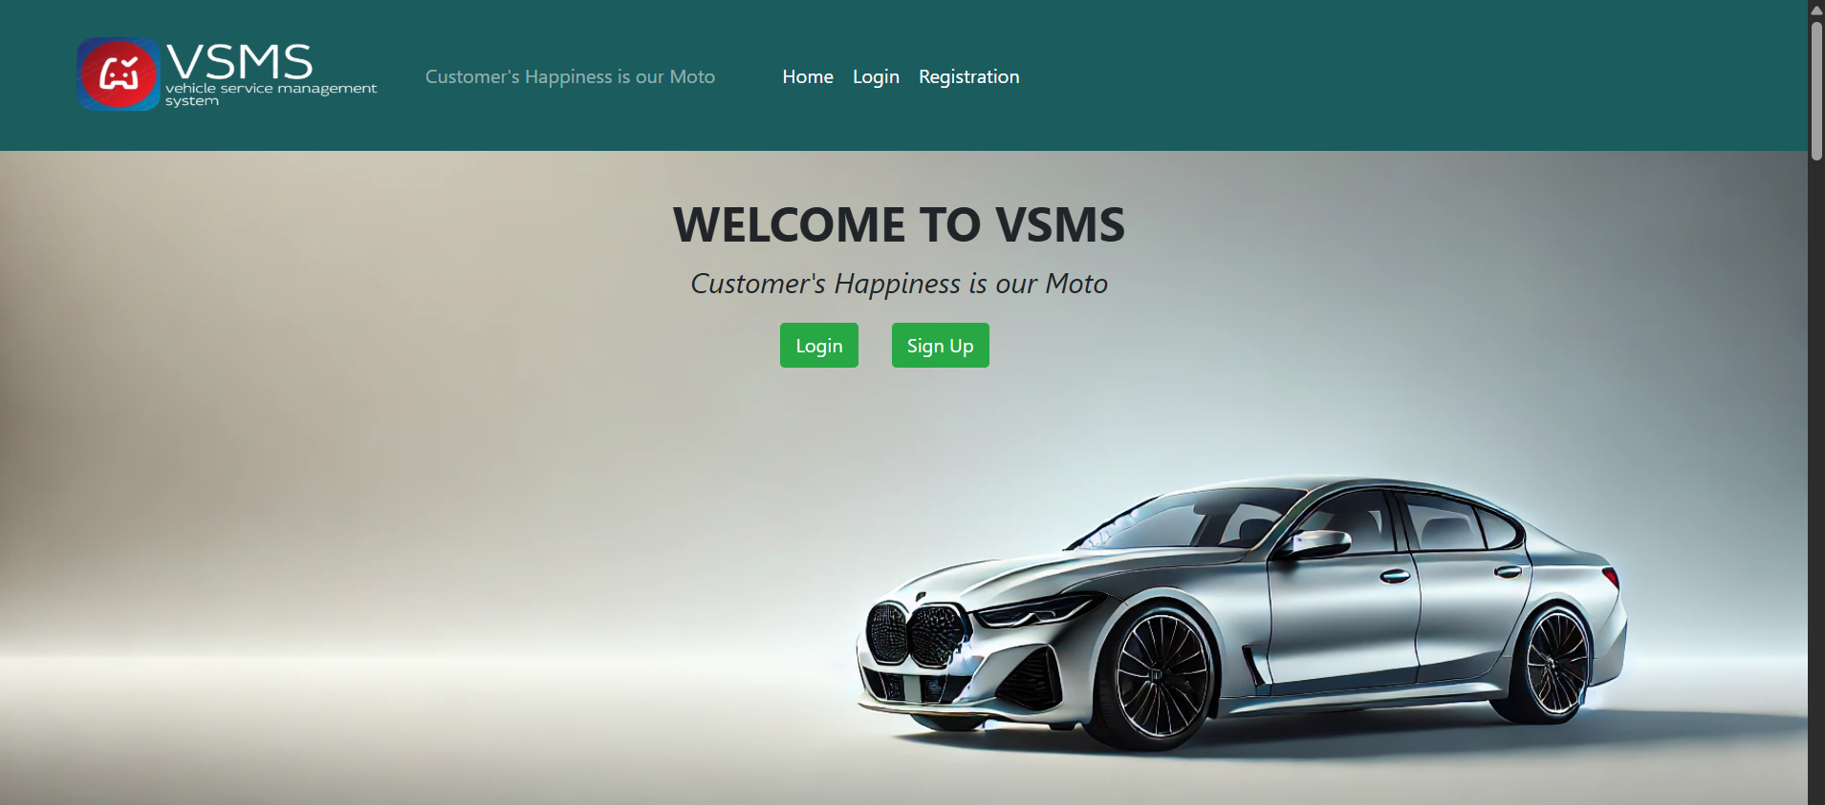
implementation
Screenshot of the system:-

Slide 17
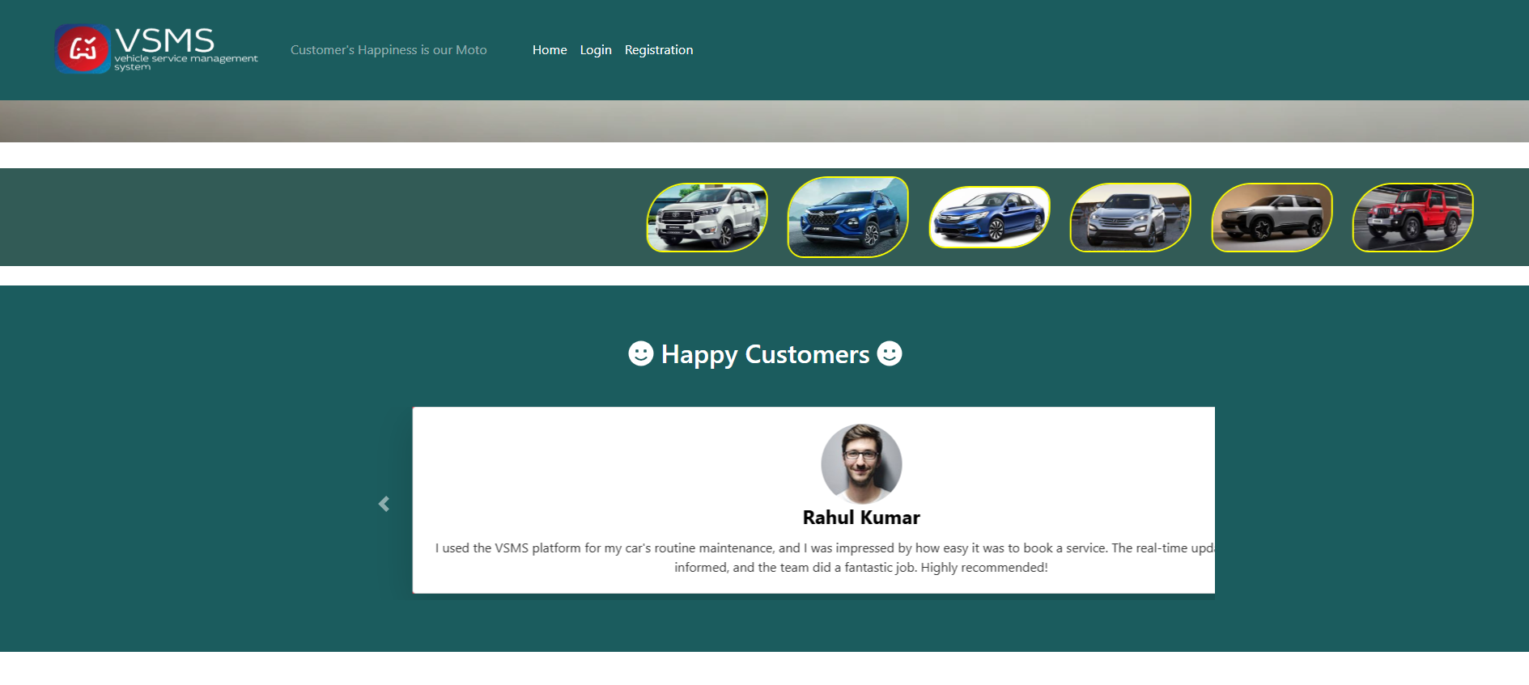
Home Page : Happy Customers

Slide 18
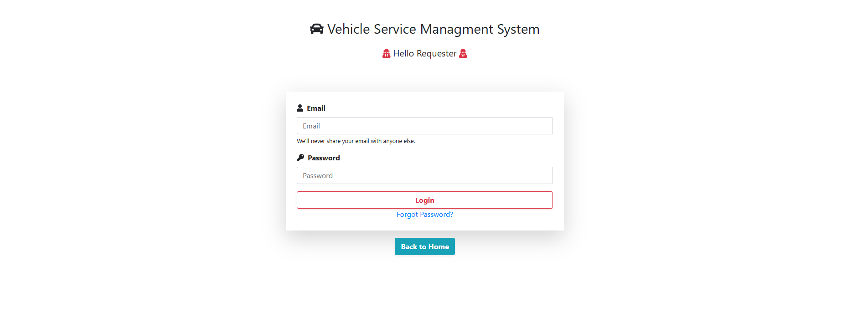
RequesterLogin.php

Slide 19
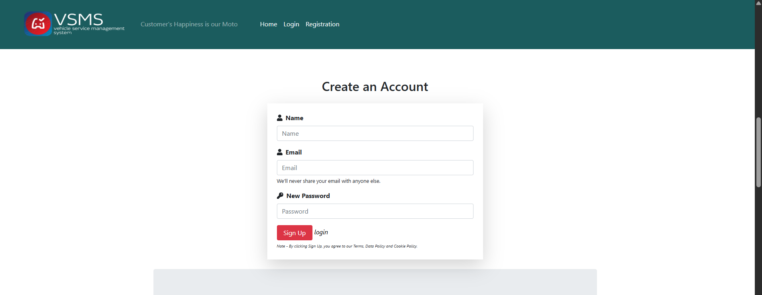
Userregistration.php

Slide 20
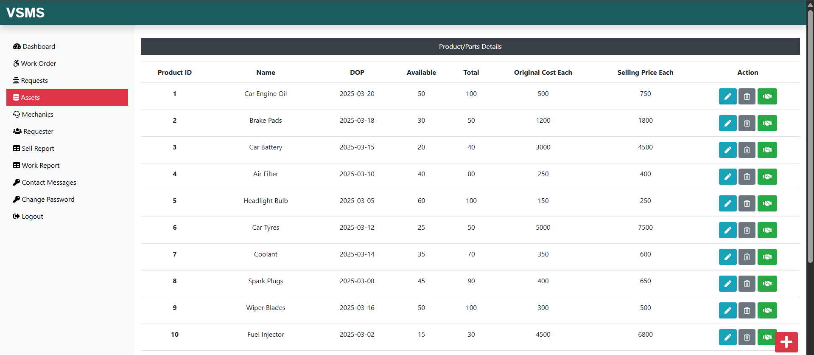
Assets.php

Slide 21
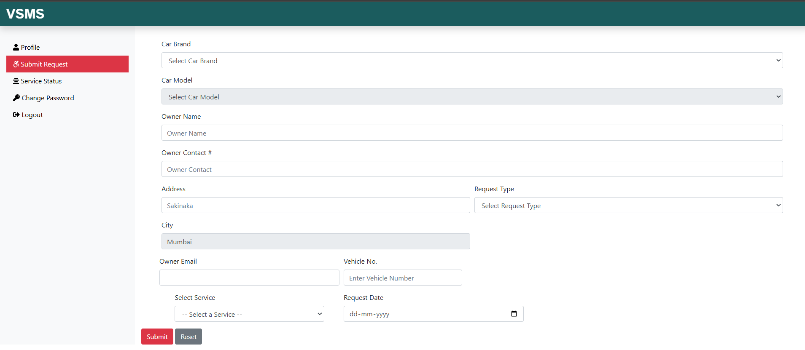
Submitrequest.php

Slide 22
⚠️ Challenges Faced
1. Database Design Complexity
Designing a normalized and scalable MySQL database was challenging due to multiple entities like Users, Vehicles, Services, Bookings, Payments, and Feedback. Ensuring relational integrity and avoiding data redundancy took significant planning.
2. User Authentication & Role-Based Access
Implementing secure login and access control for different roles (Admin, Customer, Mechanic) required careful session handling and permission management to prevent unauthorized access to admin or sensitive modules.
3. Service Booking and Scheduling
Creating a booking system that handles service type, date & time selection, and mechanic availability without overlap was tricky. Ensuring a smooth booking experience with real-time updates was a major challenge.

Slide 23
⚠️ Challenges Faced
4. Payment Gateway Integration
Integrating a secure online payment gateway and handling success/failure responses, payment confirmations, and transaction history added complexity, especially with backend and frontend coordination.
5. Frontend Form Validation & User Experience
Designing a responsive, user-friendly interface with proper HTML/CSS layout and JavaScript-based form validation was time-consuming. Ensuring usability across devices and preventing incorrect input required attention to detail.

Slide 24
🧪Testing
✅ Types of Testing Performed
Unit Testing
Each function/module (e.g., user registration, service booking, payment processing) was tested individually.
Tools: Manual PHP testing using dummy data.
Integration Testing
Ensured modules work together (e.g., booking + payment + invoice).
Verified data consistency across MySQL tables.
3. System Testing
End-to-end testing of the complete VSMS.
Validated all features like login, service management, notifications, and payment.
4. User Acceptance Testing (UAT)
Final testing by mock users to ensure system usability and performance.

Slide 25
🧪Testing
Test Case ID | Description | Input | Expected Output | Actual Output | Status
TC001 | User Registration | Valid name, email, password | User account created | Success message & user in DB | ✅ Pass
TC002 | Login Validation | Correct email & password | Dashboard loads | Dashboard opens | ✅ Pass
TC003 | Invalid Login | Wrong password | Error message | Error: Invalid credentials | ✅ Pass
TC004 | Add Vehicle | Car brand/model & user ID | Vehicle saved in DB | Vehicle shown in profile | ✅ Pass
TC005 | Service Booking | Select service, date, vehicle | Booking saved & confirmation | Booking shown in user dashboard | ✅ Pass
TC006 | Payment Gateway | Valid card details | Payment success | Confirmation message + Invoice | ✅ Pass
TC007 | Payment Failure | Invalid card details | Payment declined | Error message shown | ✅ Pass
TC008 | Admin Panel Access | Admin login | Admin dashboard access | Admin features visible | ✅ Pass
TC009 | Feedback Submission | Rating + comment | Stored in DB | Thank you message + visible in admin view | ✅ Pass
TC010 | Email Notification | After booking | Confirmation email sent | Email received | ✅ Pass

Slide 26
✅ conclusion
The Vehicle Service Management System successfully streamlines vehicle service operations
by digitizing service booking, vehicle management, invoicing, and customer communication.
It provides a user-friendly interface for both customers and admins, ensuring seamless
service workflows and real-time status tracking.
Built using HTML, CSS, JavaScript, PHP, and MySQL, the system efficiently meets the essential
needs of small to mid-sized automobile service centers.

Slide 27
🚀 Future Scope / Enhancements
The Vehicle Service Management System (VSMS) has immense potential for future enhancement and scalability. As technology advances and user expectations evolve, several features and improvements can be incorporated into the system to make it more efficient, user-friendly, and adaptable to industry standards. The future scope of the project includes:
Mobile Application Integration Development of Android and iOS applications to enable customers and service providers to manage bookings, track services, and communicate on the go.
AI-Based Chatbot Support Implementation of an AI chatbot to provide instant automated customer support, address common queries, and guide users through the service process.
GPS & Google Maps Integration Real-time tracking of vehicle pickup and delivery, navigation assistance for service personnel, and locating nearby service centers using Google Maps.
Multi-Language Support Providing multi-language interface options for wider accessibility and user convenience across regions.
Voice Command Features Enabling voice-based commands for booking services, checking service status, or navigating through the platform.

Slide 28
References : List of references
W3Schools https://www.w3schools.com/ (For HTML, CSS, JavaScript, PHP, and MySQL basics and examples)
PHP Official Documentation https://www.php.net/manual/en/ (For understanding PHP functions and server-side scripting)
MySQL Documentation https://dev.mysql.com/doc/ (For learning database creation, queries, and management)
RazorPay Developer Documentation https://razorpay.com/docs/ (For integrating payment gateway into the project)
Stack Overflow https://stackoverflow.com/ (For solving real-time coding errors and troubleshooting issues)

Slide 29
References : List of references
GeeksforGeeks https://www.geeksforgeeks.org/ (For understanding AJAX implementation and various programming concepts)
PHPMailer Documentation https://github.com/PHPMailer/PHPMailer (For setting up email notifications in PHP using Google SMTP)
Bootstrap Official Site https://getbootstrap.com/ (For designing responsive layouts and mobile-first designs)
YouTube Tutorials (Various tutorials for PHP Projects, and Admin Panel Designs)

Slide 30
Thank you

